Slide 1






Flutter as a Feature:
Fusing Flutter Web and ReactJS
Presented By
Shivam Srivastava

Slide 2

WHO AM I ?
Shivam Srivastava
8 years as Mobile Developer
Senior Tech Lead - Mobile
Citridot Solutions, Hyderabad
Android Native, Flutter
Trying React Native too
Content Creation in Mobile Dev (Flutter)

Slide 3



02
Current Development Scenario
Got New Project ?

Slide 4

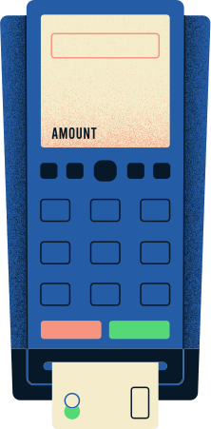


02
Current Development Scenario
POS App
Dashboard
Got New Project ?
Communication
IoT Based

Slide 5















03
Deciding Tech Stack (Native)
BACKEND
MOBILE
DESKTOP
Front End
Web

Slide 6



04
Completion
Advertising Presentation | December 2020
Shipped to Production

Slide 7
03
New Feature required ?
Feature to be developed for each platform
Web App
Multiple developers working on same feature
MOBILE

Slide 8
03
New Feature required ?
Feature to be developed for each platform
Web App
Multiple developers working on same feature
Sudden new changes ?
Multiple iteration of changes across platform
MOBILE
Time Consuming?, Need to Ship faster...

Slide 9
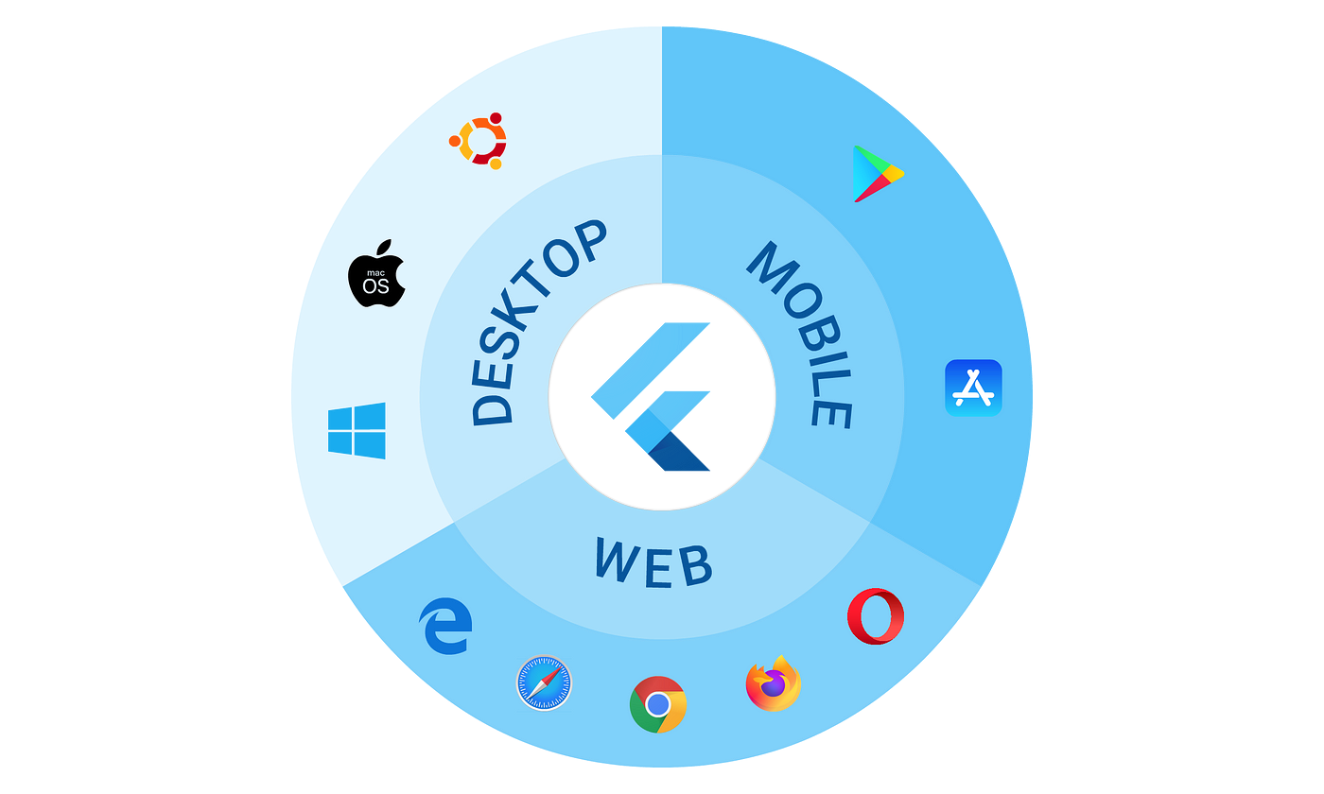

05
Dart and Flutter
Cross Platform
Framework

Slide 10
03
Flutter as Feature (aka Add to App)
Existing apps
MOBILE
FeatureA
Module
Front End
Web

Slide 11
06
Flutter as Feature...
NATIVE APP
FLUTTER UI
UI
Logic
Events
DART Logic
Assets
Assets

Slide 12


06
Flutter Web Works?
dart compile js
DART LOGIC
JAVASCRIPT
flutter build web
FLUTTER UI
FLUTTER WEB APP

Slide 13
05
Dart - Interoperability
Dart interoperability refers to the ability of Dart code to interact with code written in other languages,
Dart enables seamless interoperability with existing JavaScript libraries and frameworks. You can easily call JavaScript functions from your Dart code and call Dart code from Javascript code
compile/interop
Dart Logic
Javascript

Slide 14
06
Flutter as Feature... (Web)
1. Shared Logics - Dart only
2. Embed View - Flutter Web App
<iframe>
Redirect <a href=” ”>
3. On Demand - Realtime interaction

Slide 15
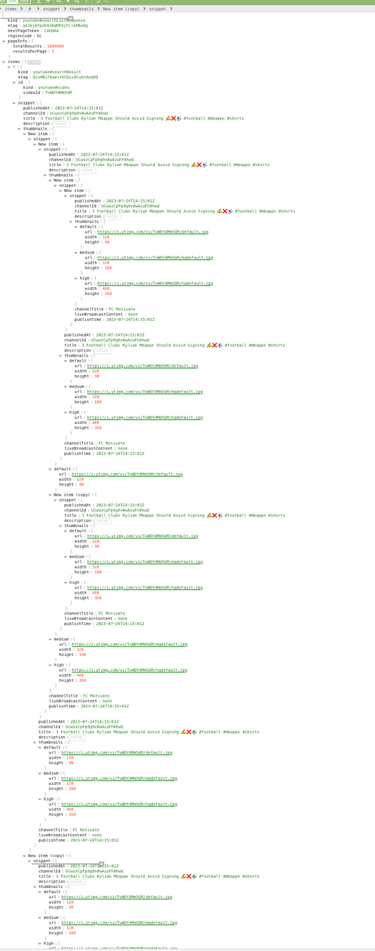
06
Dart as Shared Logic
1. MANAGING JSON PARSING
2. COMMON TASK FOR MOBILE AND WEB
3. 99% CODE RESUABLE

Slide 16
05
Dart-Js Interop - DEMO

Slide 17


05
Dart as Sharing Logic
compile
Generated Js Code
Shared Logic
in Dart
Build
Script
Server
Web App
Web Project

Slide 18
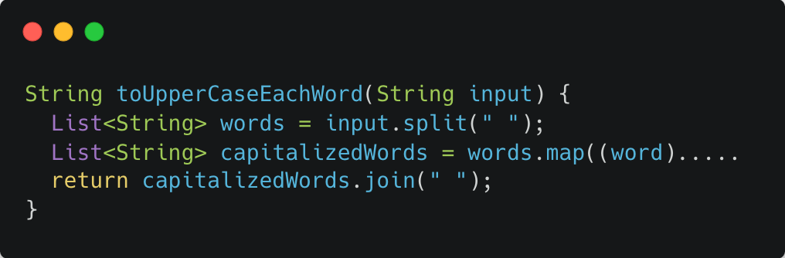
05
Dart-Js Interop - Implementation
someDartCode.dart

Slide 19
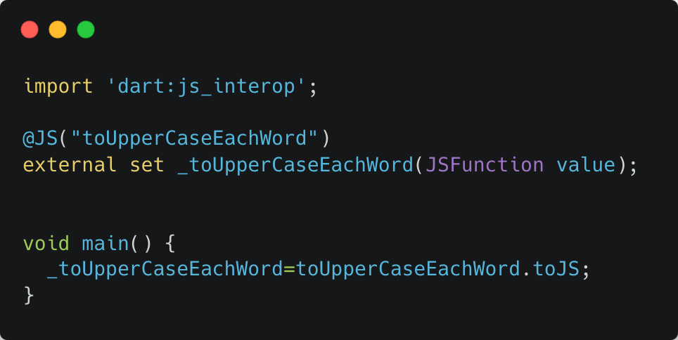
05
Dart-Js Interop - Declaration
someDartCode.dart

Slide 20
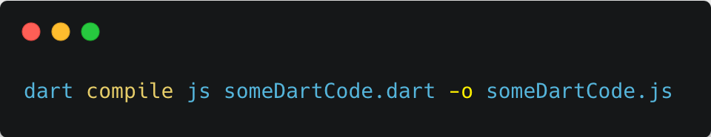
05
Dart-Js Interop - Compile

Slide 21
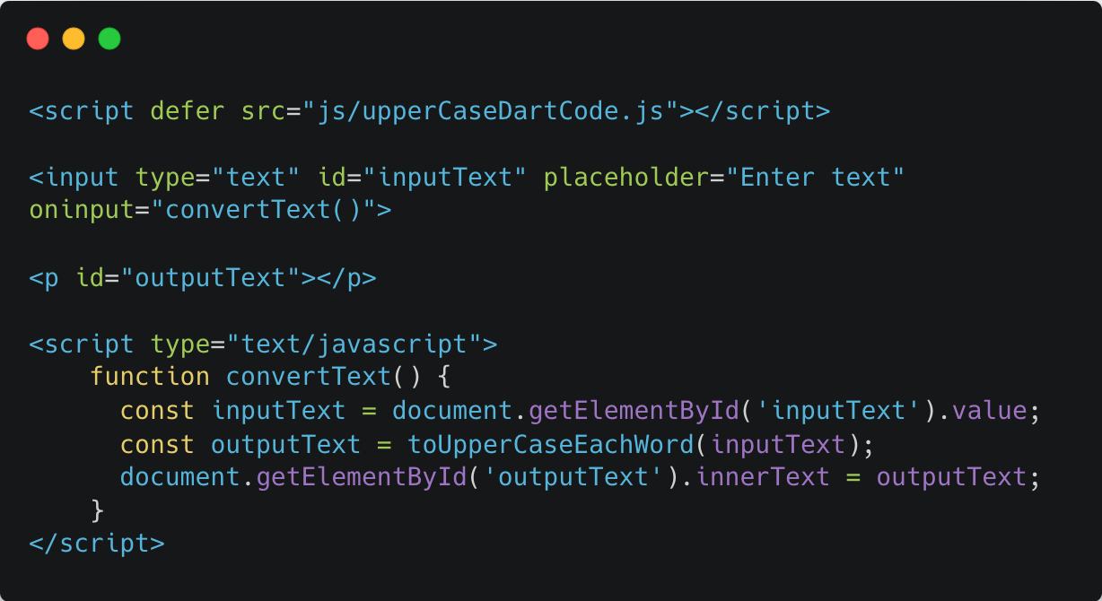
05
Dart-Js Interop - Usage

Slide 22
06
Flutter as Module
1. Module with exact functionality and UI across mobile and web platform
2. Common Feature(UI) for Mobile and Web
4. Code Reusability

Slide 23

06
Flutter as Module
User
Mobile
Features:
Data Entry UI
RestAPI
Camera
GPS
File Handling
Custom Painter

Slide 24
06
Flutter as Module
User
Mobile

Slide 25
06
Flutter as Module
Editor
web app
User
Mobile

Slide 26
06
Flutter as Module
Admin
web app
Editor
web app
User
Mobile

Slide 27
06
Flutter as Module
1. 90% of code Re-used in Mobile and Web
2. Flutter package handles Camera and GPS
across mobile and web app
3. Shipped faster, save time

Slide 28
05
Flutter as Module - Embed
Flutter Build
compile
UI + Logic
Script
Server
Web App
Web Build
React Project

Slide 29
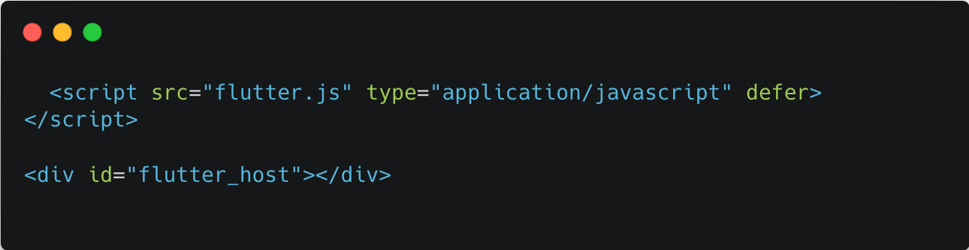
Flutter as Module
Implementation

Slide 30
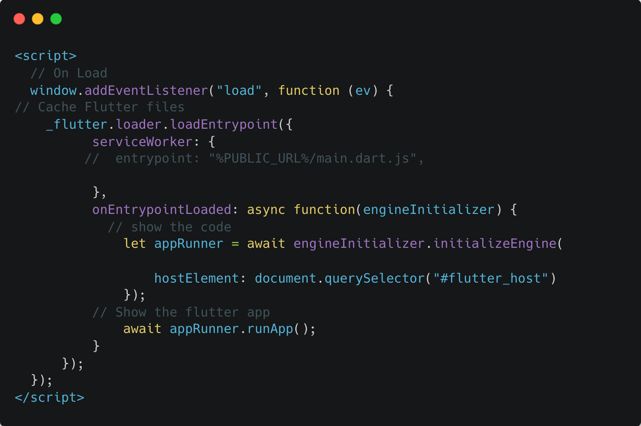
Flutter as Module - Embed
Initialization

Slide 31
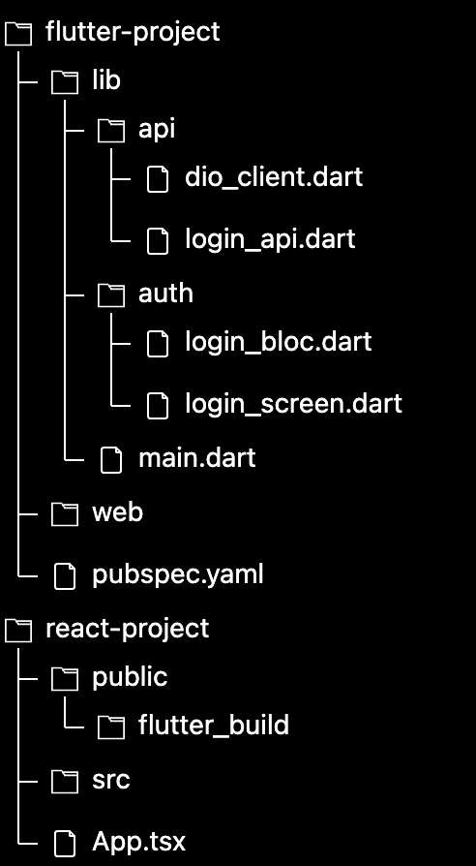
05
Flutter as Module
Project Structure

Slide 32
06
Flutter as Module - Embed
Demo

Slide 33
05
Flutter as Module - On Demand
Build
flutter build web
UI + Logic
Load on Demand
Events
Server
Web App
Web Build
React Project

Slide 34
06
Flutter as Module - On Demand
Demo

Slide 35














03
Feature Ready
Authentication
File Handling
Media
Security
Responsive UI
Rest API
Firebase
Search / Sort
Charts
Localization
Location
Camera
Payments
Analytics
Real Time
Local Caching

Slide 36

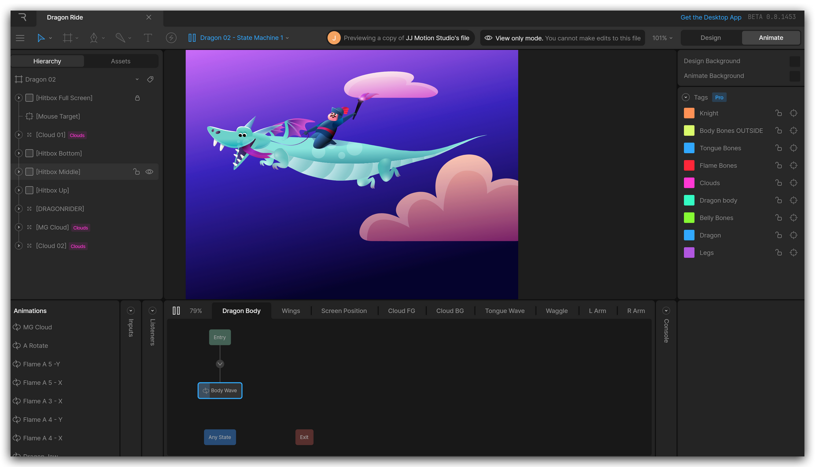
Flutter Web Apps
06

Slide 37

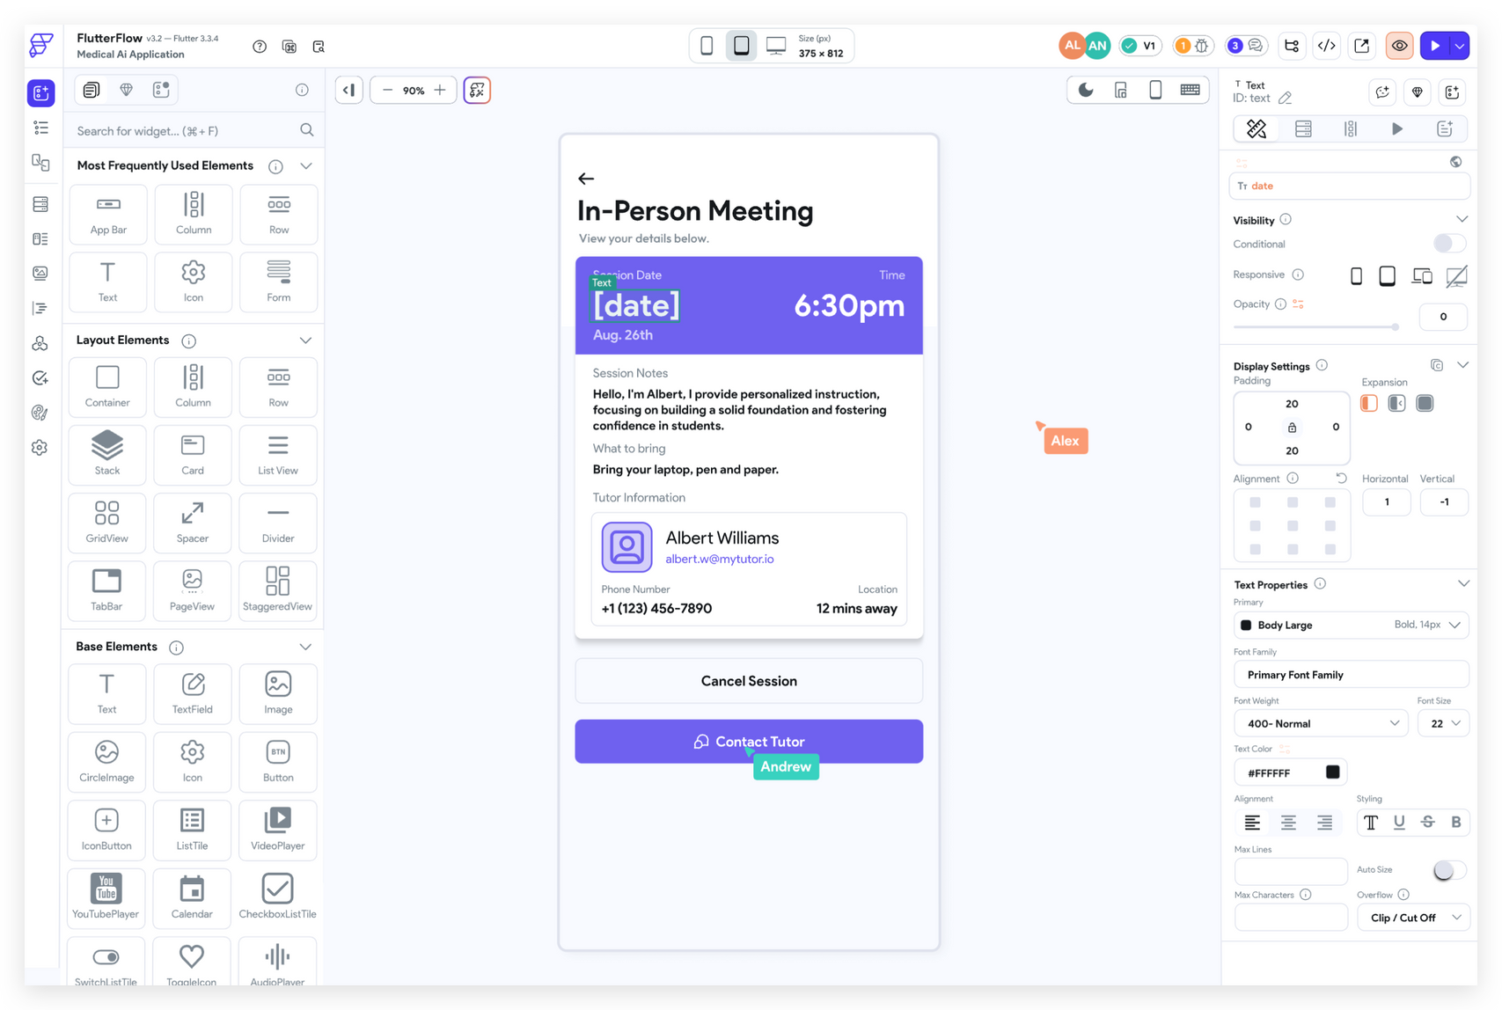
Flutter Web Apps
06

Slide 38

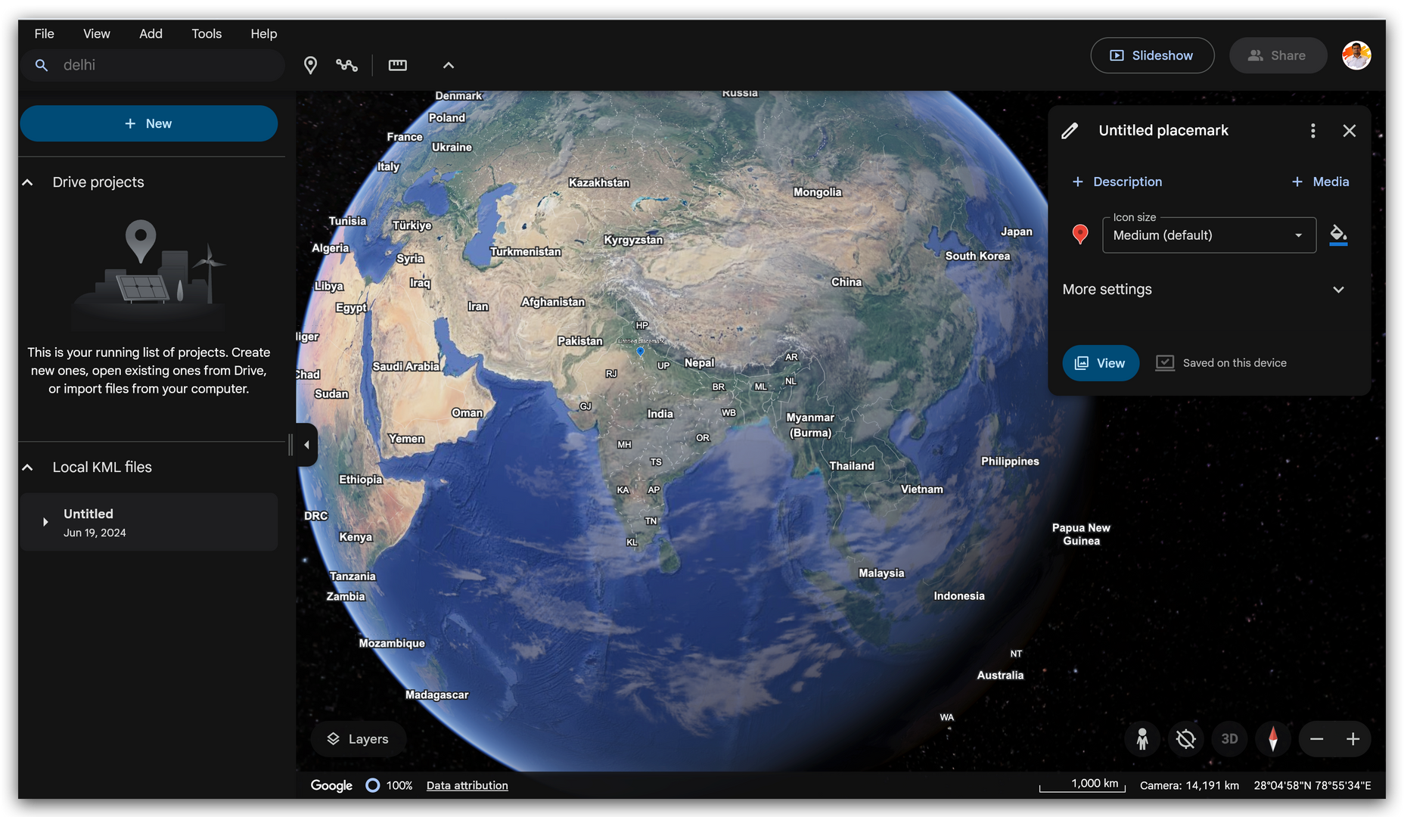
Flutter Web Apps
06

Slide 39



Slide 40

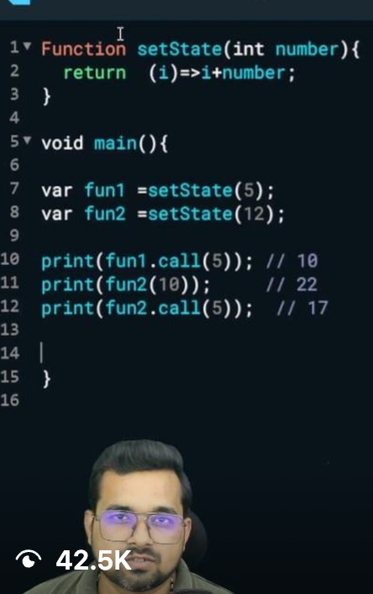
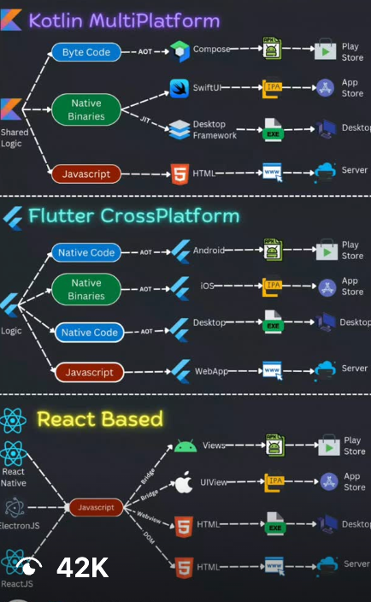






@NavokiTech
@TheShivamLko
@TheShivamLko

